Slide 1
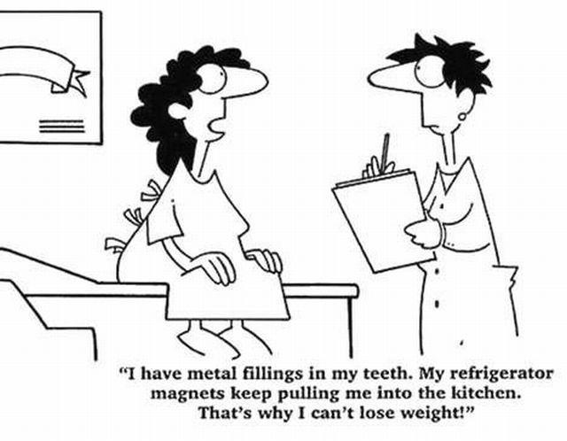
Magnets and Magnetic Fields

Slide 2

Magnets
Magnetic Fields
The Earth’s Magnetic Field
Electromagnetism

Slide 3
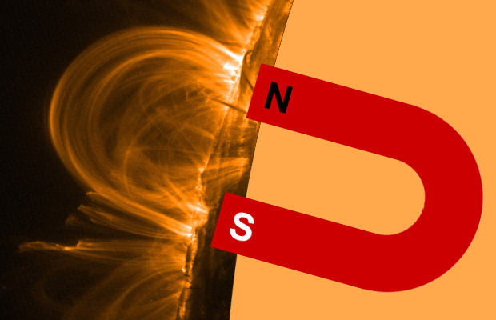
ALL magnets have two poles
NORTH seeking pole
SOUTH seeking pole

Slide 4
Breaking a magnet produces two magnets!
N
S
N
S
N
S

Slide 5
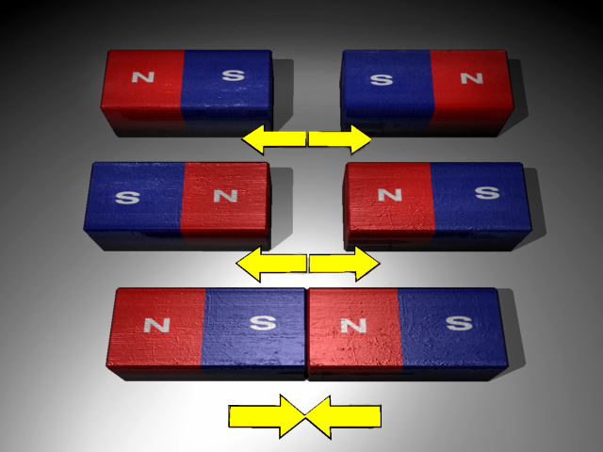
Opposite poles attract and like poles repel

Slide 6
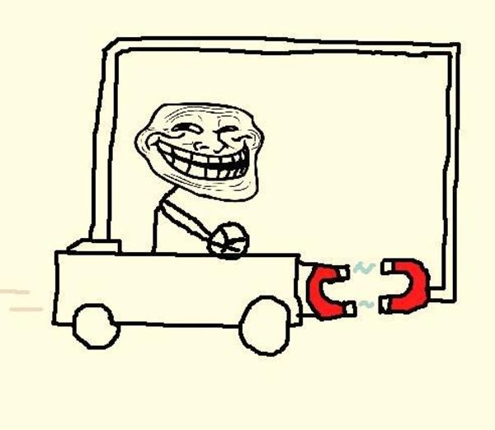
Opposite poles attract and like poles repel

Slide 7
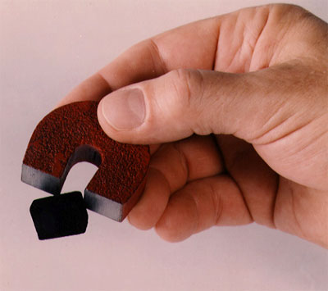
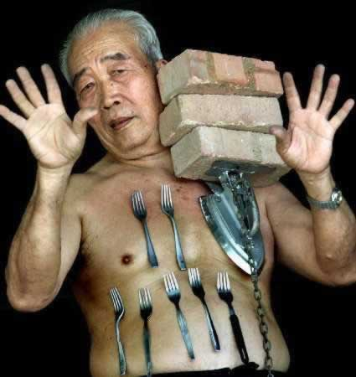
Magnetic materials
Iron (steel), Cobalt and Nickel

Slide 8
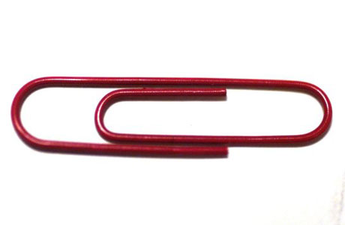
Induced Magnetism
When a magnetic material is close to a magnet, it becomes a magnet itself
We say it has induced magnetism
magnet
S
N
S
N

Slide 9
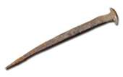
Soft Magnetism
Pure iron is a soft magnetic material
It is easy to magnetise but loses its magnetism easily
before
after
N
S
S
N
S
N
N
Not a magnet
Iron nail

Slide 10

Hard Magnetism
Steel is a hard magnetic material
It is harder to magnetise, but keeps its magnetism (it is used to make magnets!)
before
after
S
N
S
N
S
N
N
S
N
It’s a magnet!
Steel paper clip

Slide 11
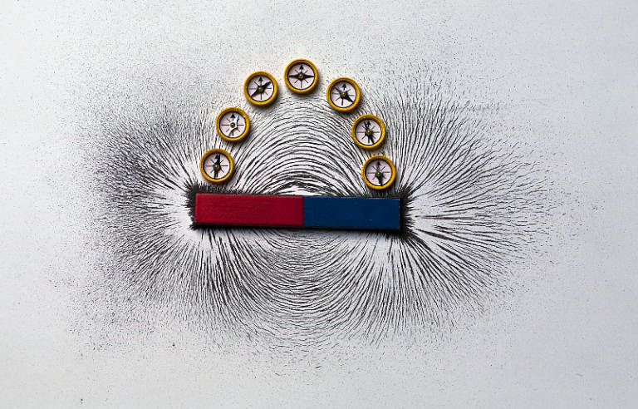
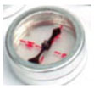
Magnetic Fields
The shape of a magnetic field can be observed using a plotting compass.

Slide 12
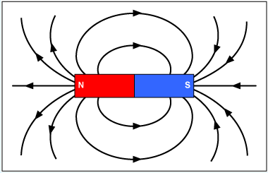
Magnetic field around a bar magnet
We can represent the magnetic field around a wire or magnet using field lines (lines of flux).

Slide 13
Magnetic field around a bar magnet
We can represent the magnetic field around a wire or magnet using field lines (lines of flux).
The arrows show the direction the north pole of a compass needle would point at that place in the field.

Slide 14
Magnetic field around a bar magnet
Flux lines come out of the North pole and go
into the South pole of the magnet.

Slide 15
Magnetic field around a bar magnet
The closer the field lines are, the stronger the magnetic force felt. We say that the “flux density” is greater there.
Weaker force due to lower “flux density”

Slide 16
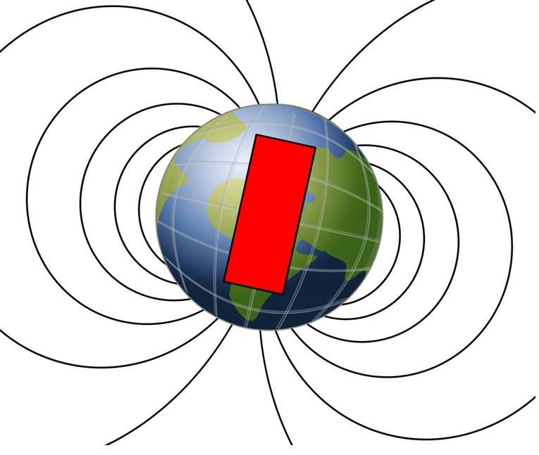
The Earth’s Magnetic Field
Remember the North of a compass aligns itself with the magnetic field?
Which way do compasses point on the Earth?
What does that mean?
?

Slide 17

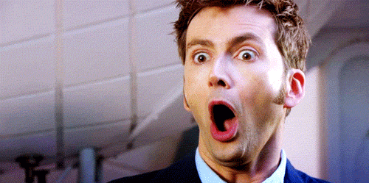
The Earth’s Magnetic Field
The Earth’s NORTH pole behaves more like the SOUTH pole of a Magnet!
S
N
MIND BLOWN

Slide 18
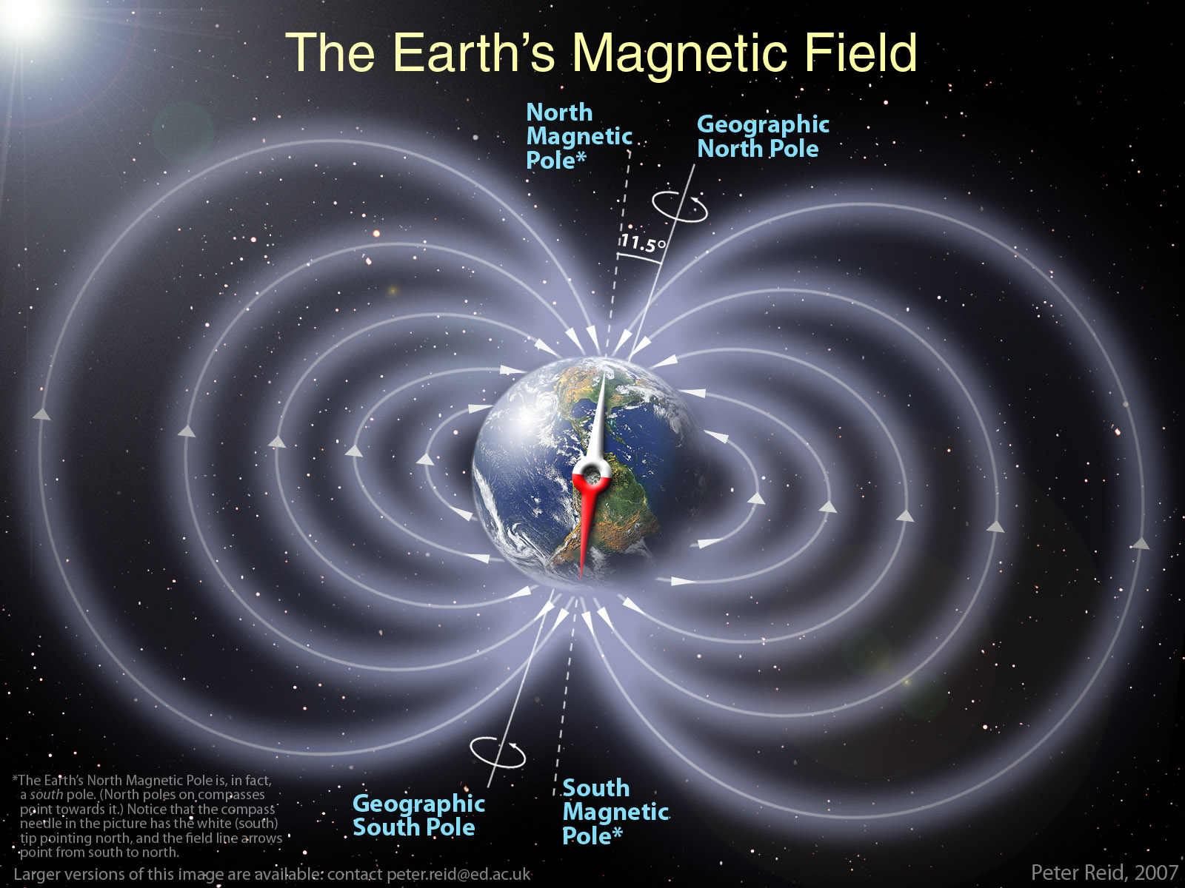

Slide 19
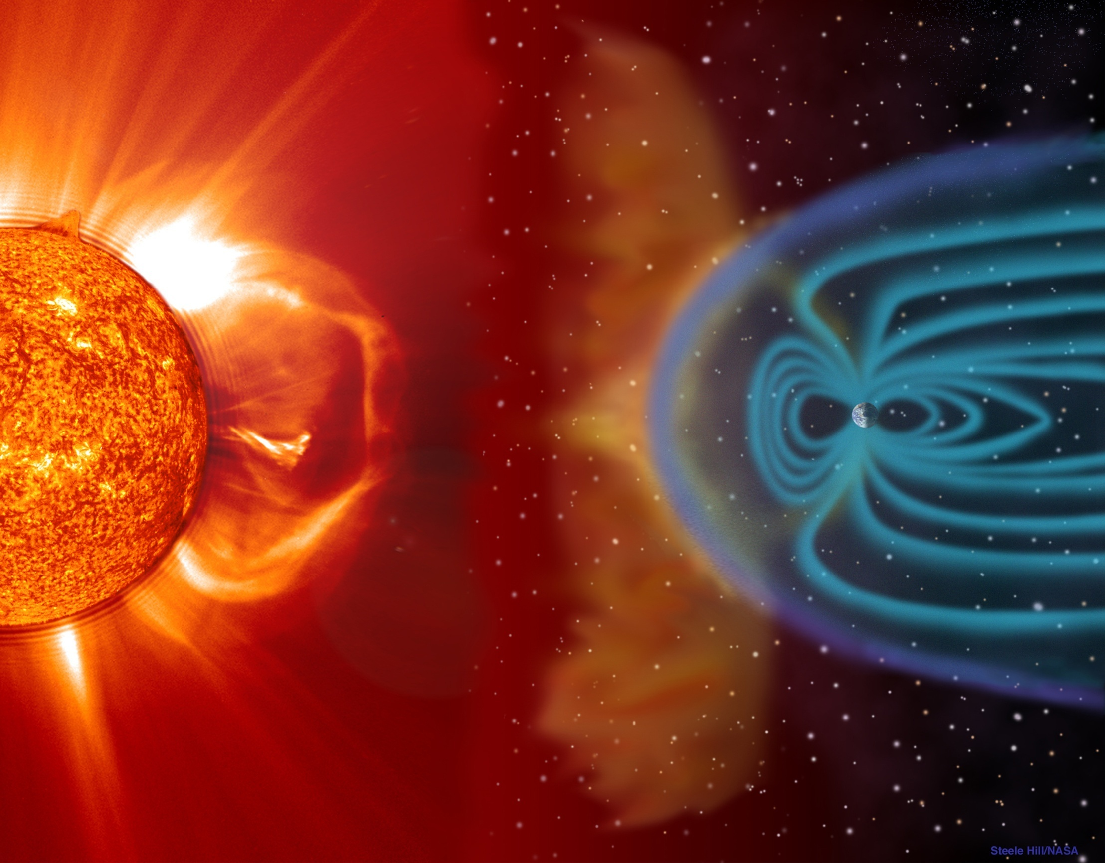

Slide 20
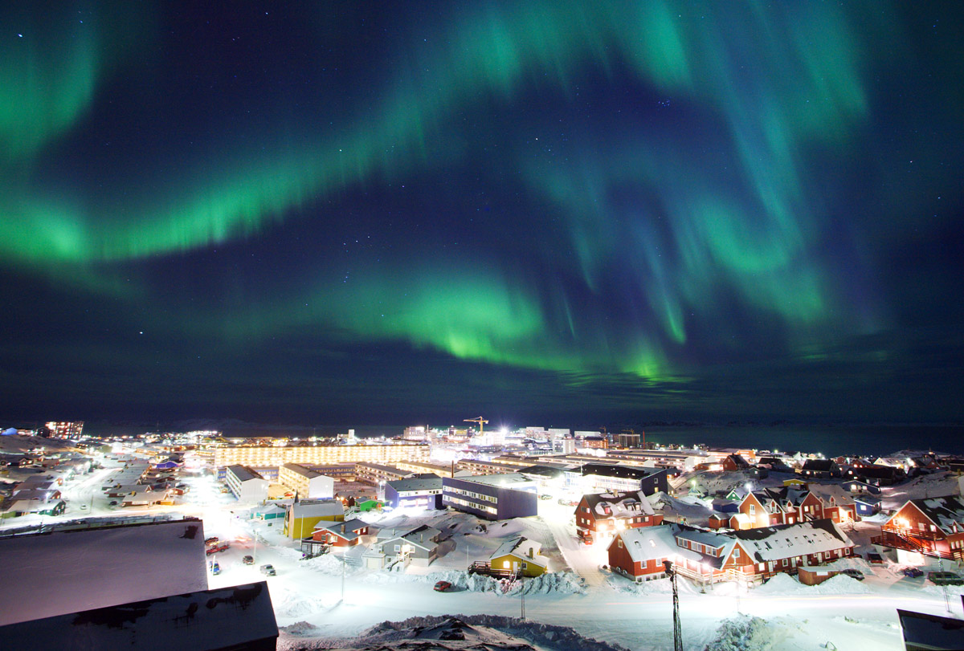

Slide 21
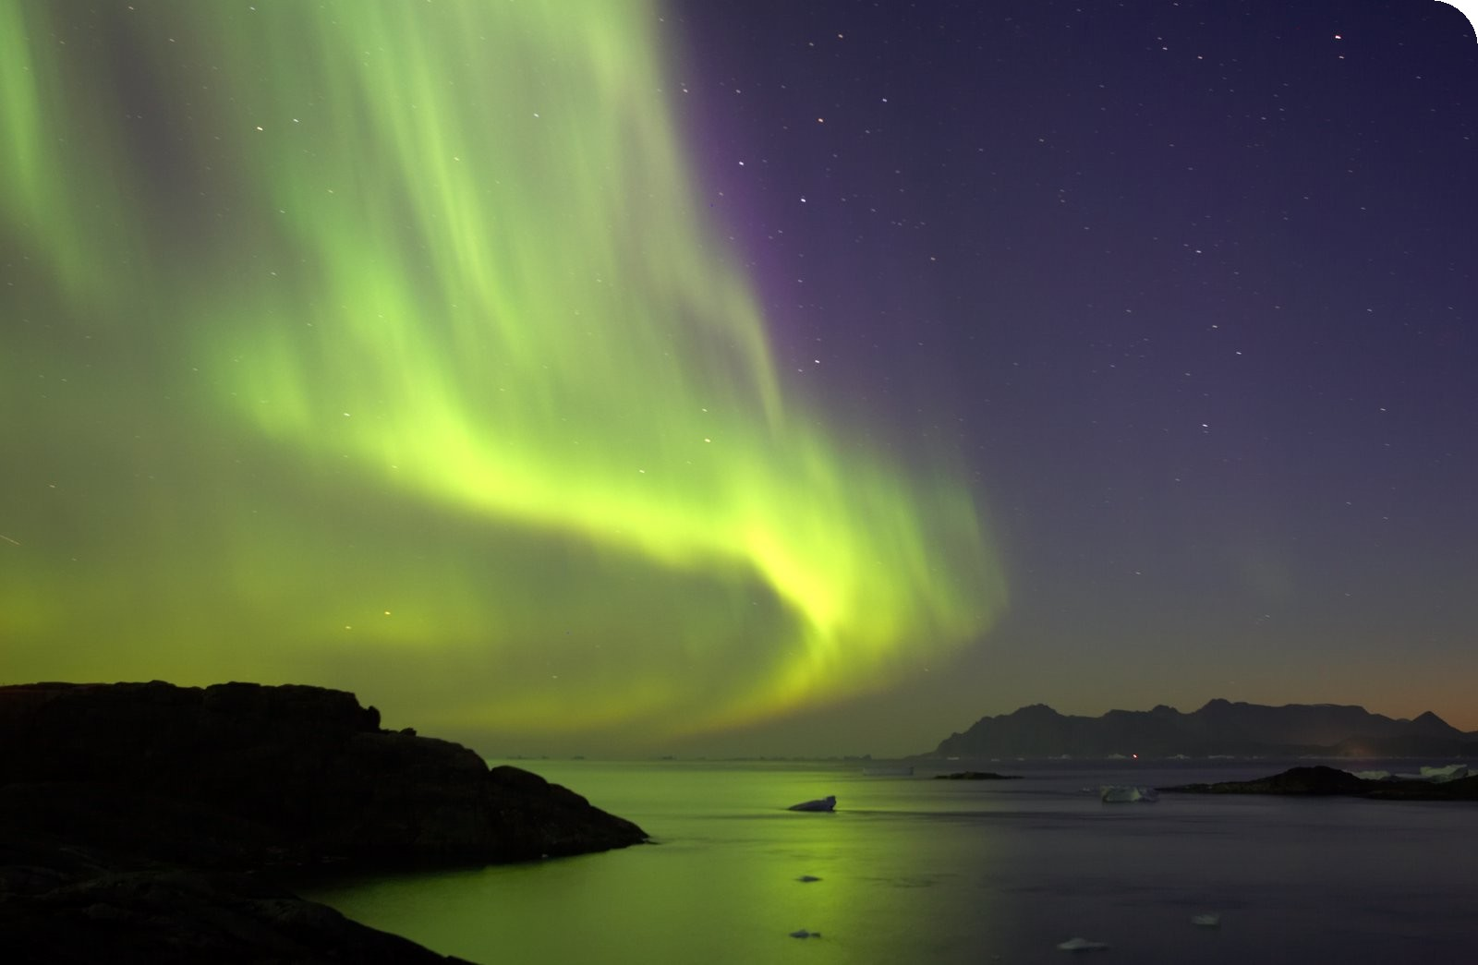

Slide 22
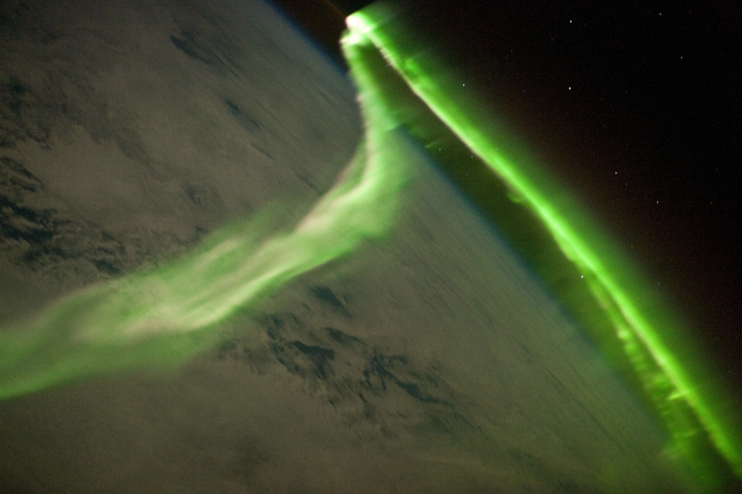

Slide 23
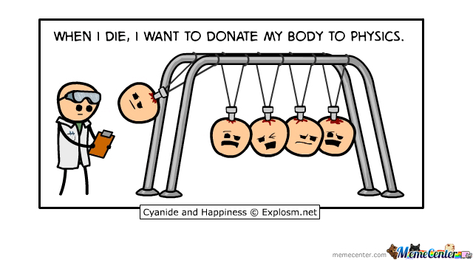

Slide 24
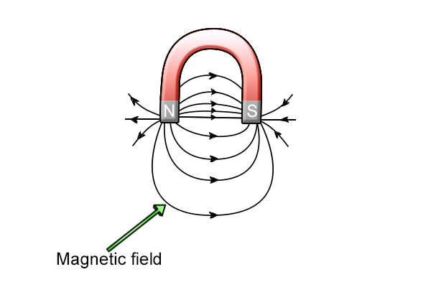
Magnetic field around a Horseshoe magnet
The“flux density” is greater there.
Weaker force due to lower “flux density”

Slide 25
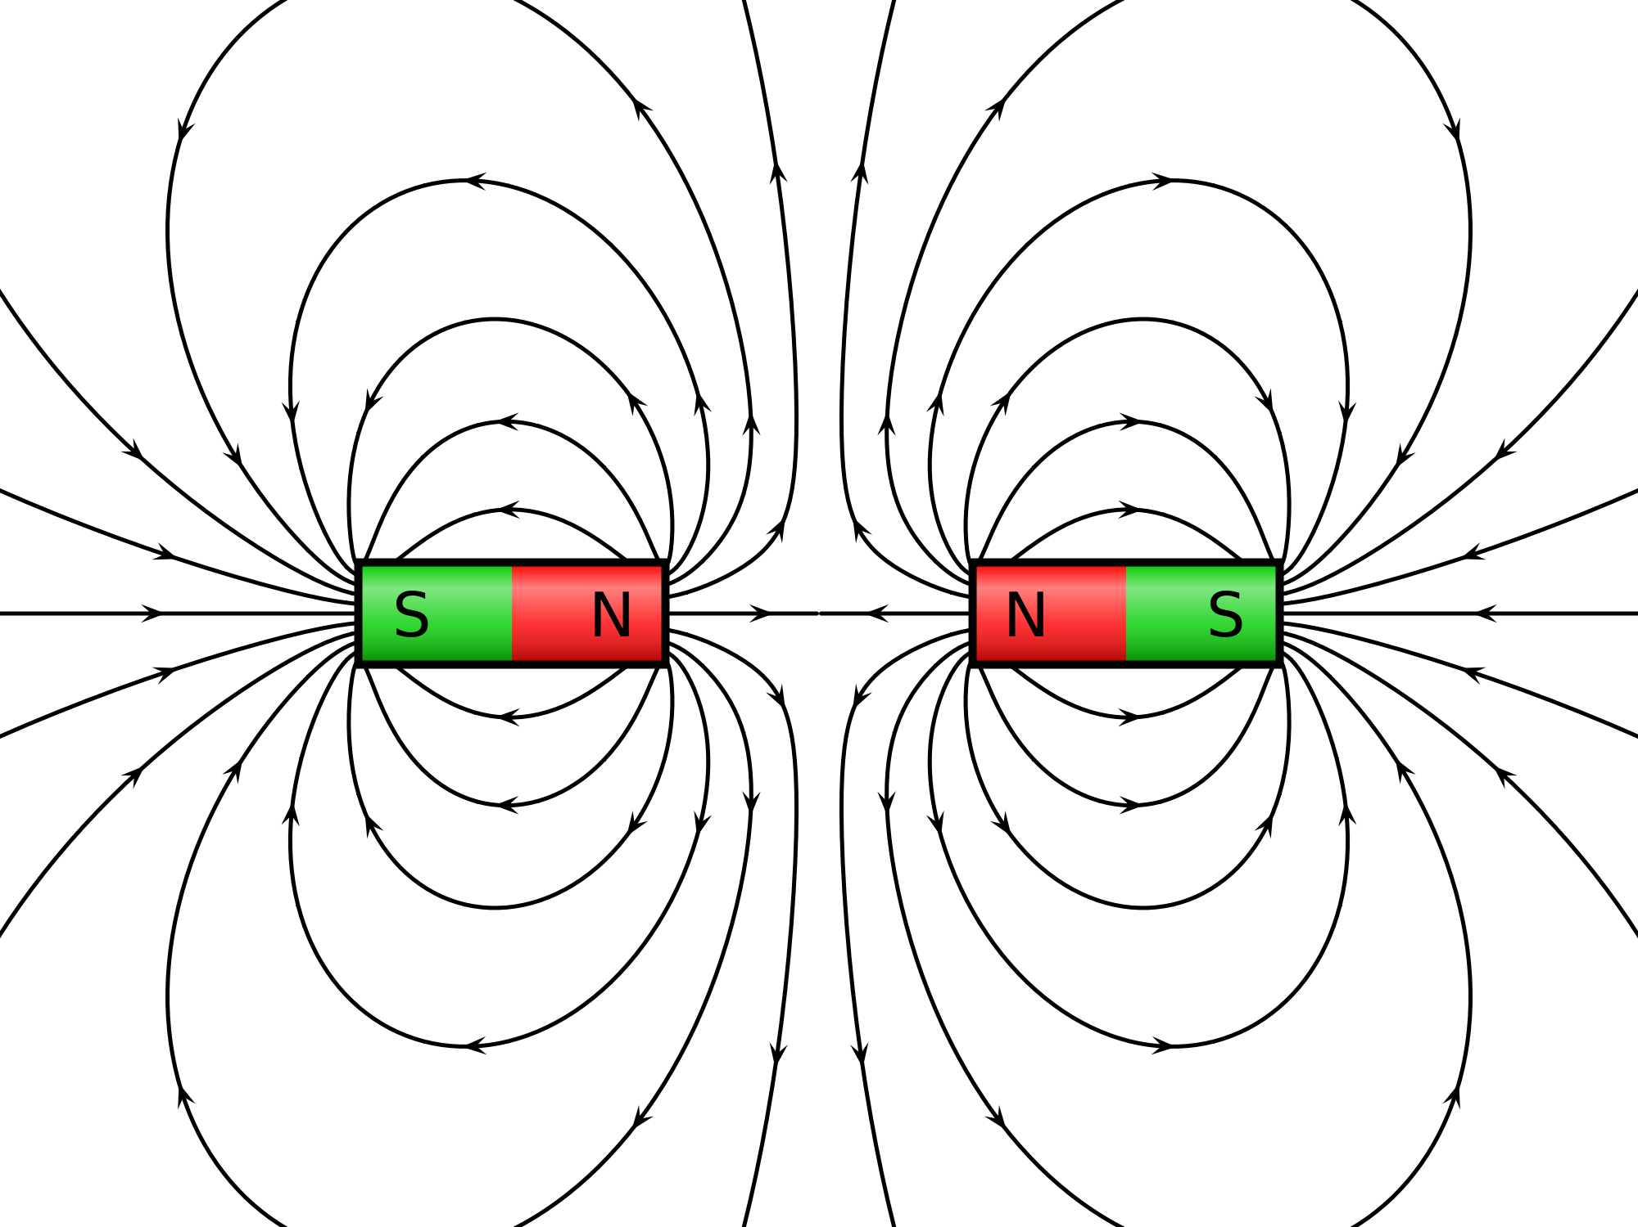
MULTIPLE MAGNETS
Magnetic Fields are combined as Vectors

Slide 26
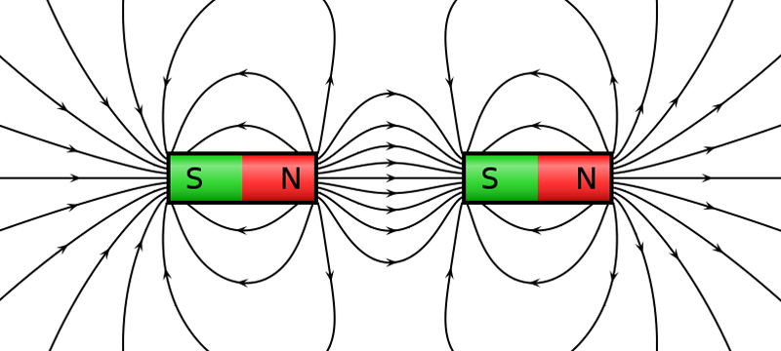
MULTIPLE MAGNETS
Magnetic Fields are combined as Vectors

Slide 27
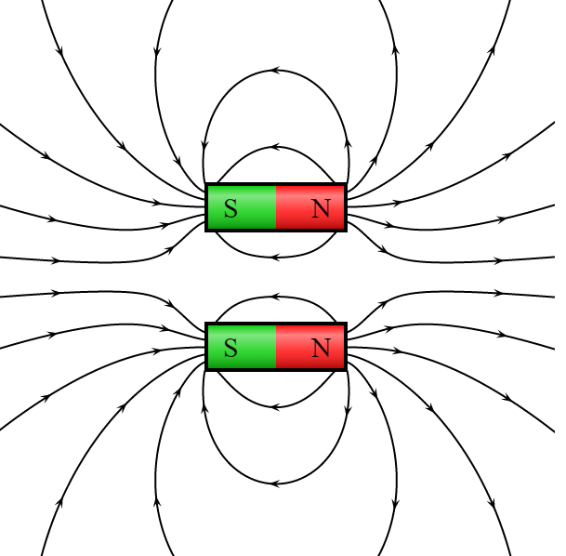
MULTIPLE MAGNETS
Magnetic Fields are combined as Vectors

Slide 28
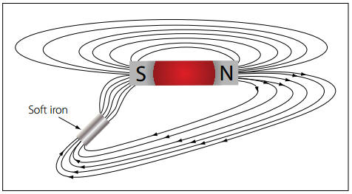
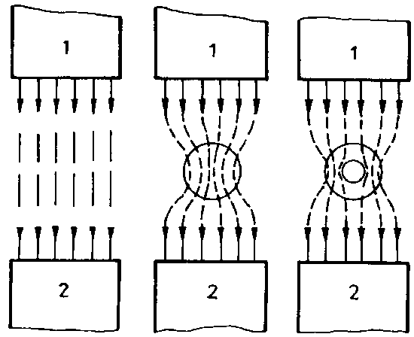
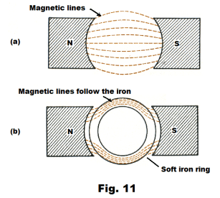
MULTIPLE MAGNETS
Magnetic Fields are deflected towards and through soft iron.
The field is concentrated in the iron

Slide 29
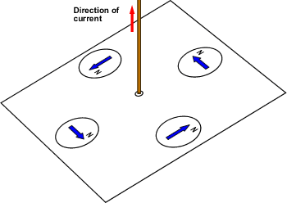
Electromagnetism?
What does electricity have to do with magnetism?
If compasses are placed around a wire carrying a strong enough current, they will be deflected.
This indicates that current produces a magnetic field.

Slide 30
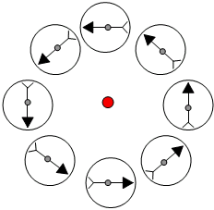
Electromagnetism?
The deflection direction is perpendicular to the direction of current but varies depending on where the compass if placed indicating a circular field around the conductor.

Slide 31
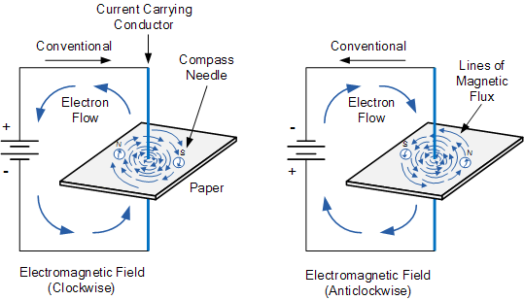
Electromagnetism?
If the current direction is reversed the direction of the circular magnetic field is also reversed.

Slide 32
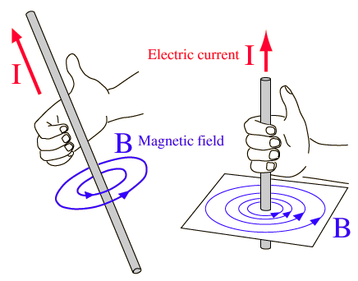
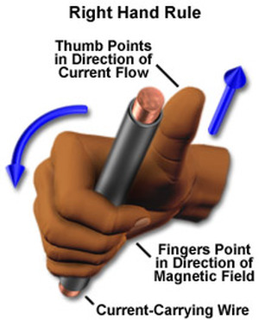
Moving charges (currents) – Right Hand Curl Rule
Moving charges (electric currents) also produce a magnetic field
Conventional current – so electrons flow in the opposite direction

Slide 33
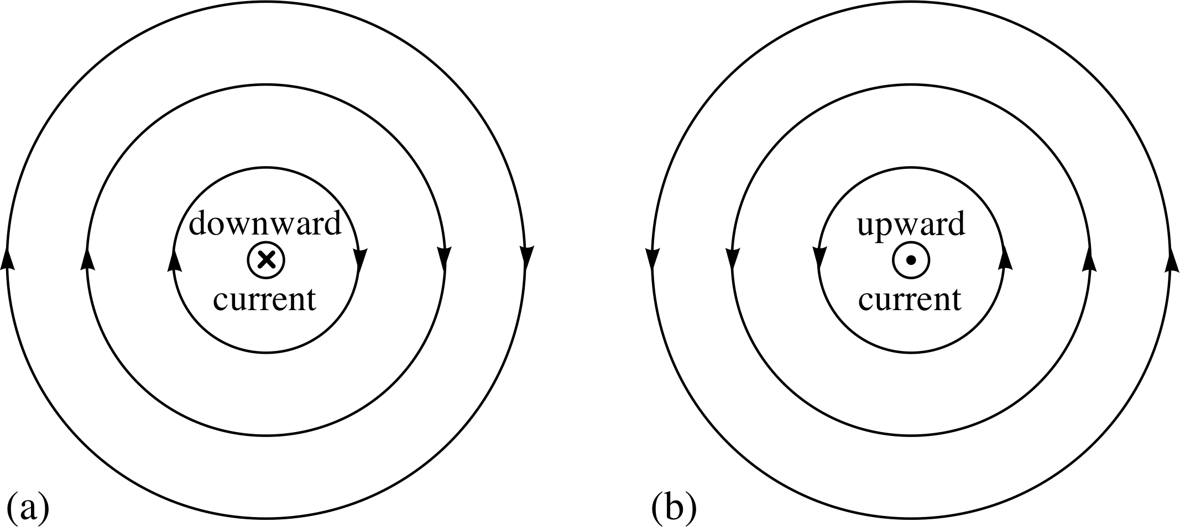
Moving charges (currents) – Right Hand Curl Rule
We use an X to show current moving into the page / screen and a dot ● top show it coming out. Think of these as the point and the fletching of an arrow or dart

Slide 34
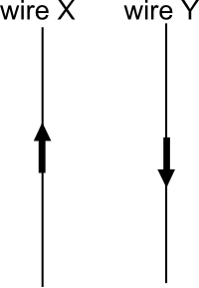
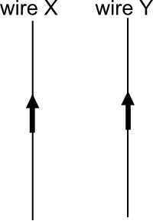
What happens if two wires carrying current are put close to each other? Try drawing the fields that are produced by each wire.

Slide 35
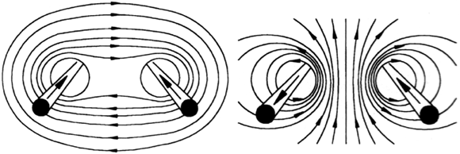
What happens if two wires carrying current are put close to each other?

Slide 36
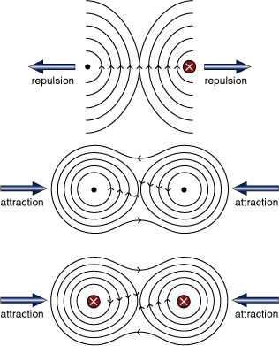
What happens if two wires carrying current are put close to each other?

Slide 37
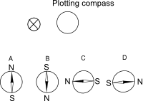
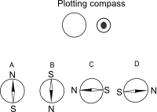
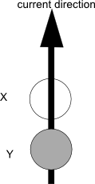
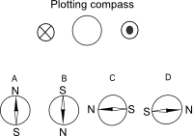
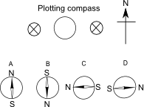
Which direction will the plotting compass point?

Slide 38
What will happen to the Wires?

Slide 39
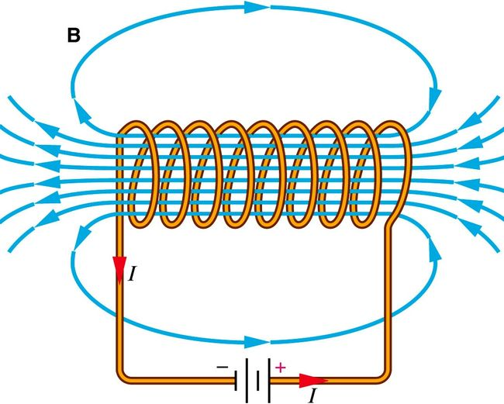
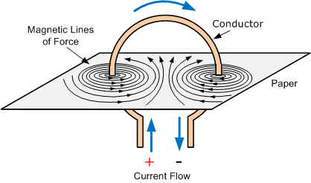
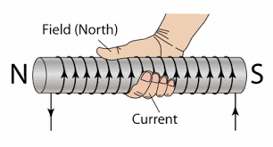
Current Carrying Coils - Solenoids
A coil of wire produces a more intense magnetic field. We call this a SOLENOID or commonly an electromagnet,

Slide 40
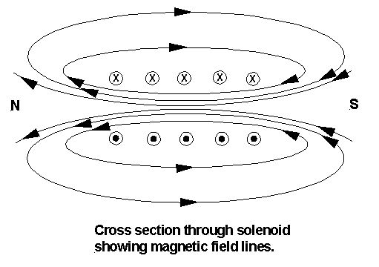
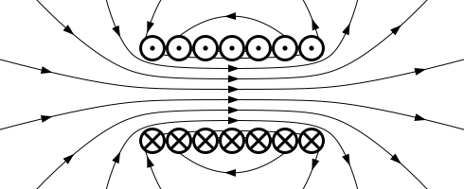
Current Carrying Coils - Solenoids

Slide 41
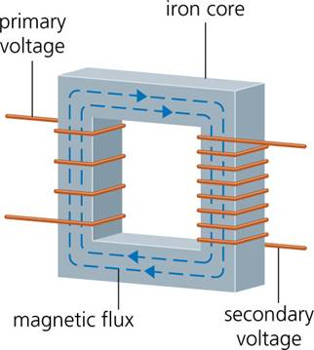
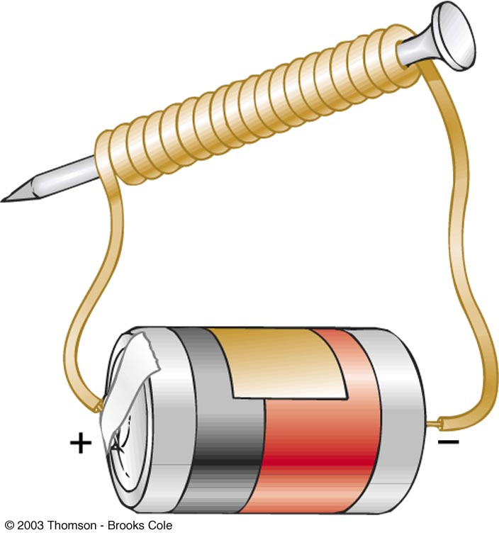
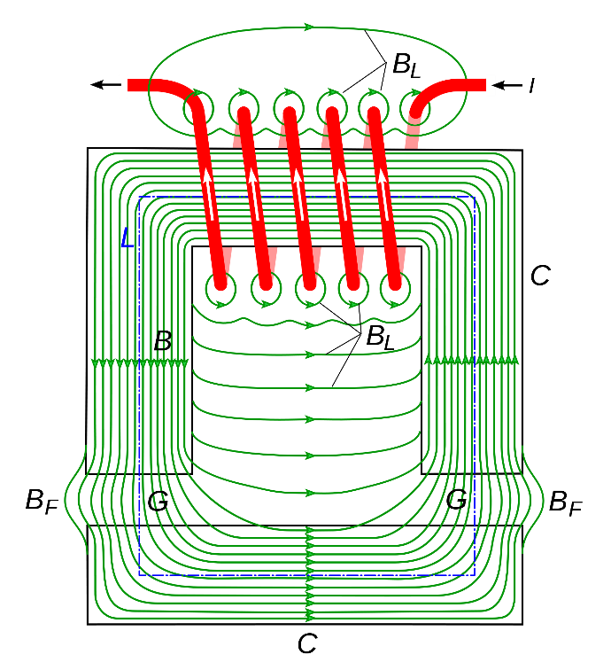
Current Carrying Coils - Solenoids
Soft iron can be used to concentrate (increase the strength of a solenoid)
and direct the field to where it is needed.

Slide 42


